Slide 1
Compilers 101
MLIR - Part 1

Slide 2
Compilation flow
C/CPP file
Preprocessing
Is that it?
Can we have different inputs?
Is there a chance for an alternative flow?
Lexical analysis
Syntax analysis
Semantic analysis
IR Generation
IR Optimization
Optimization
Code generation
Object file

Slide 3
Today
Why MLIR?
MLIR history
MLIR description
Usage scenarios

Slide 4
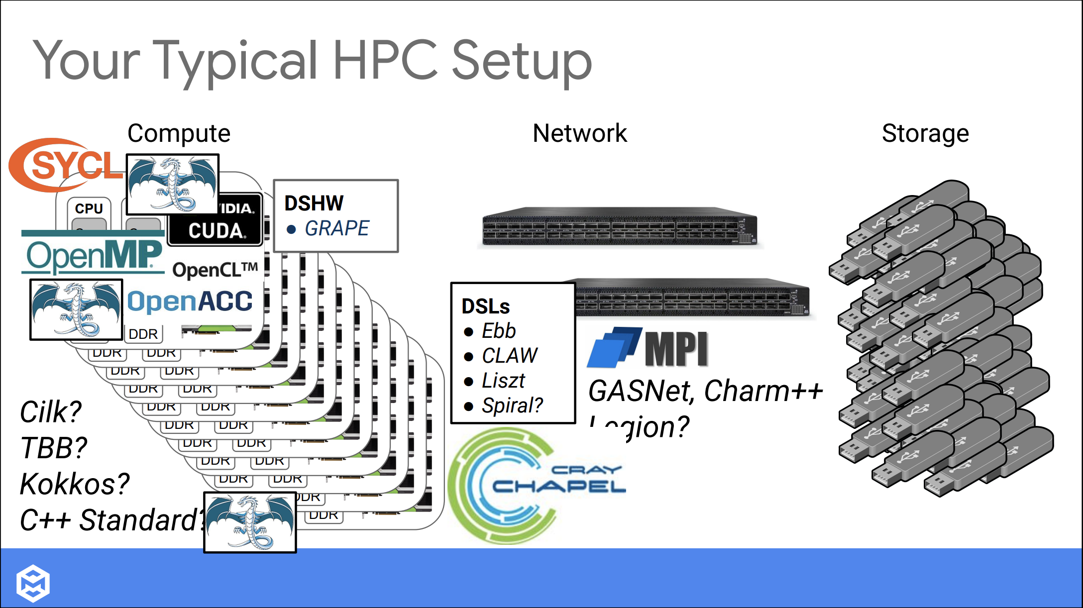
https://llvm-hpc-2020-workshop.github.io/presentations/llvmhpc2020-amini.pdf

Slide 5

MLIR intro
MLIR stands for Multi-Level Intermediate Representation
MLIR is a framework for building custom intermediate representations
Collection of basic algorithms for general-purpose IR transformations
Basic data structures
Custom parsers and printers
https://blog.google/technology/ai/mlir-accelerating-ai-open-source-infrastructure/

Slide 6
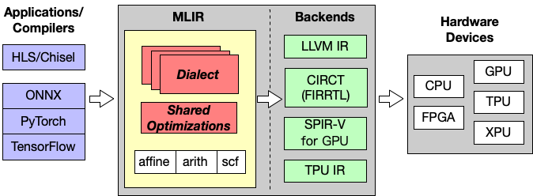
MLIR
http://lastweek.io/notes/MLIR/

Slide 7
MLIR
Supports diverse domains
Machine Learning
Hardware development
Custom Domain Specific Languages (DSL)
LLVM IR
Provides a view on the source code from different levels

Slide 8
MLIR history: pre-historic era
Before MLIR was conceived, the LLVM project already had a powerful intermediate representation (IR) that was highly effective for optimizing and generating machine code for CPUs.
However, as the landscape of computing hardware grew to include GPUs, TPUs, and other accelerators, it became apparent that LLVM IR was not ideally suited for representing the high-level, domain-specific abstractions needed by these new architectures.

Slide 9
MLIR history: beginning
MLIR was officially announced and open-sourced by Google in April 2019, but its development started much earlier, around 2018, as a collaboration between different teams within Google and eventually with external contributors
The project was born out of the need for an infrastructure that could bridge the gap between high-level, domain-specific representations of programs and the low-level, hardware-specific code required to execute them efficiently

Slide 10
MLIR history: nowadays
MLIR infrastructure is being developed rapidly
Top industry companies use that:
Google
Meta
Microsoft
Intel
AMD
other…

Slide 11
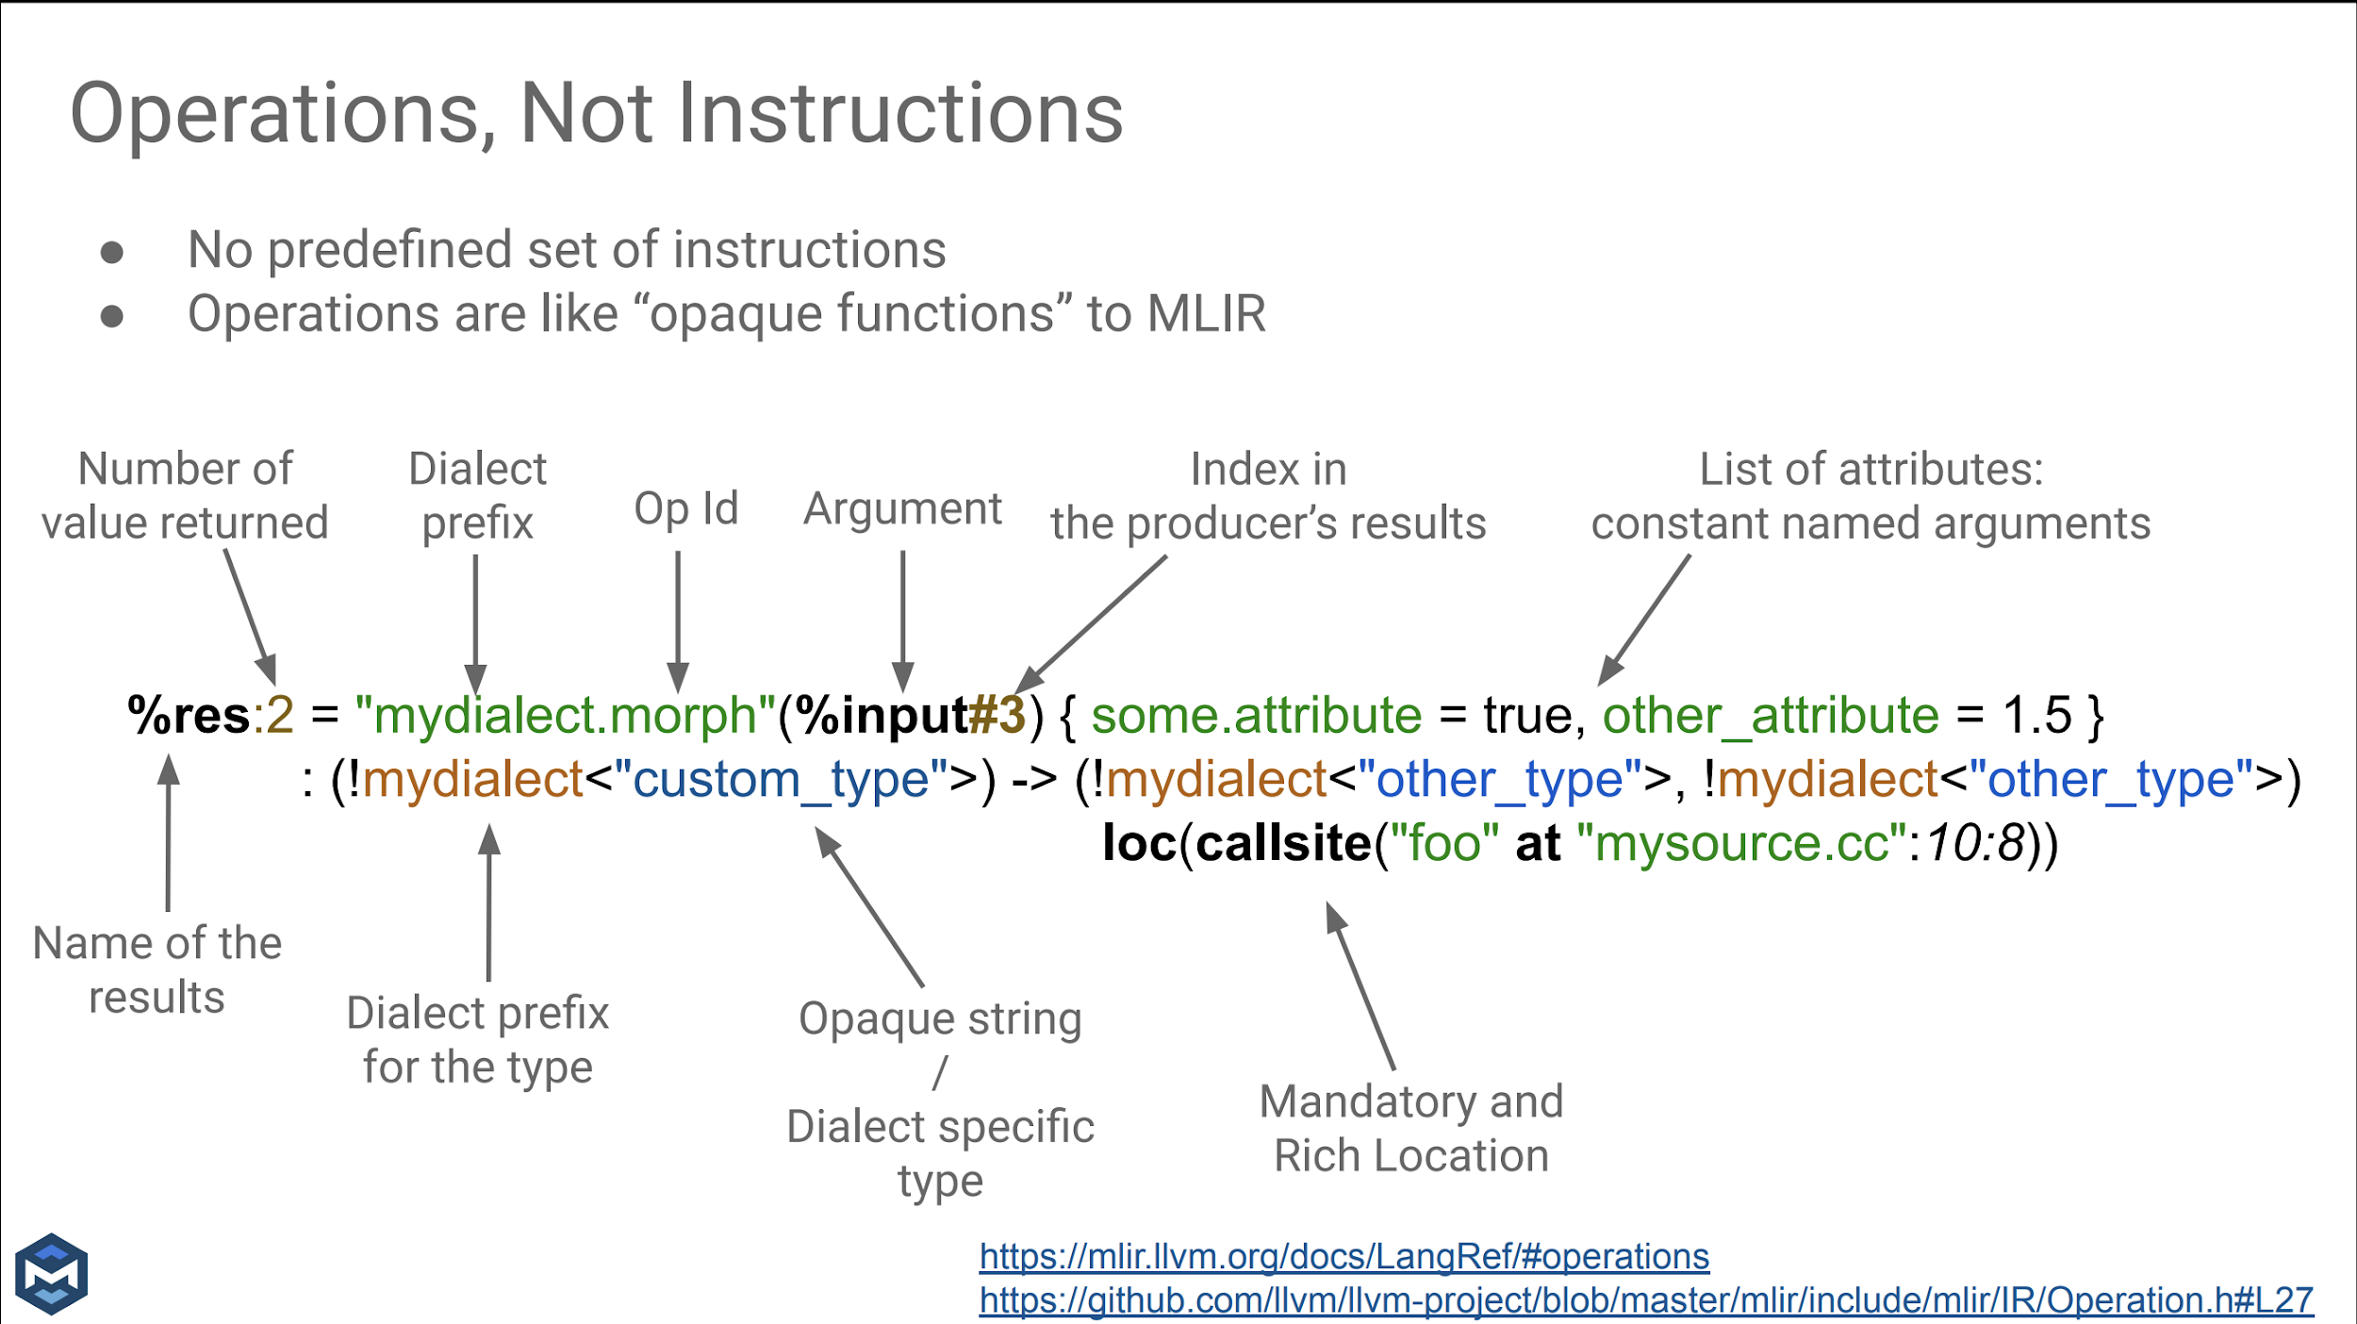

Slide 12
Dialects
Extensible collections of operations and types that represent various levels of abstraction or domains.
Dialects represent modular structure of combining operations
Dialects are basically custom IRs
Custom data types, custom operations, custom syntax
Example dialects: arithmetic, affine, omp, spv, linalg

Slide 13
Dialects
'acc' Dialect
'affine' Dialect
'amdgpu' Dialect
'amx' Dialect
'arith' Dialect
'arm_neon' Dialect
'arm_sve' Dialect
'ArmSME' Dialect
'async' Dialect
'bufferization' Dialect
'cf' Dialect
'complex' Dialect
'dlti' Dialect
'emitc' Dialect
'func' Dialect
'gpu' Dialect
'index' Dialect
'irdl' Dialect
'linalg' Dialect
'llvm' Dialect
'math' Dialect
'memref' Dialect
'mesh' Dialect
'ml_program' Dialect
'mpi' Dialect
'nvgpu' Dialect
'nvvm' Dialect
'omp' Dialect
'pdl_interp' Dialect
'pdl' Dialect
'quant' Dialect
'rocdl' Dialect
'scf' Dialect
'shape' Dialect
'sparse_tensor' Dialect
'tensor' Dialect
'ub' Dialect
'vcix' Dialect
'vector' Dialect
'x86vector' Dialect
Builtin Dialect
SPIR-V Dialect
Tensor Operator Set Architecture (TOSA) Dialect
Transform Dialect
Documentation:
https://mlir.llvm.org/docs/Dialects/

Slide 14
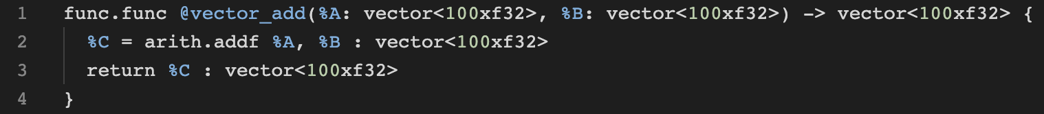

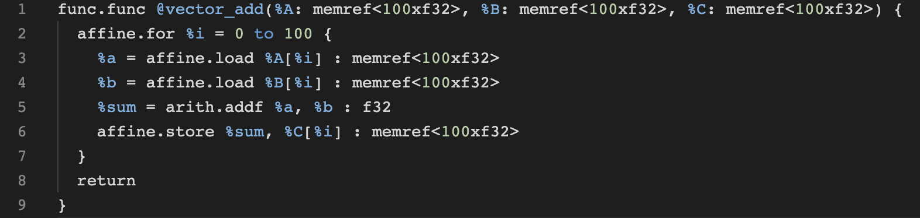
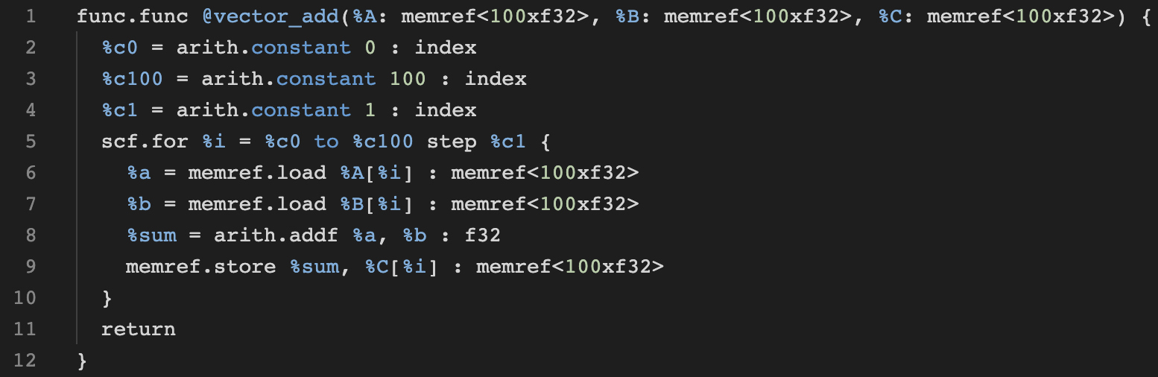
Multi level examples
Vector:
https://godbolt.org/z/oj1TErxv9
Affine:
https://godbolt.org/z/P7KTrW665
scf + memref:
https://godbolt.org/z/o883bEjr7

Slide 15
MLIR transformations
Affine -> scf:
scf -> cf:
SCF - structured control flow
CF - control flow
https://godbolt.org/z/zcYnsTEvz
https://godbolt.org/z/95o1nvrsM

Slide 16
Why do we need dialects?
MLIR is suited to define IRs on different levels of abstractions
Built-in dialects
represent more or less generic operations (arith, scf, memref, llvm)
operations used in LLVM stack and needed in the community (x86vector, arm_sve)
It provides an infrastructure to add different dialects
ML frameworks use that (PyTorch aten dialect, onnx dialect, tf dialect) to represent supported network layers for further lowering

Slide 17
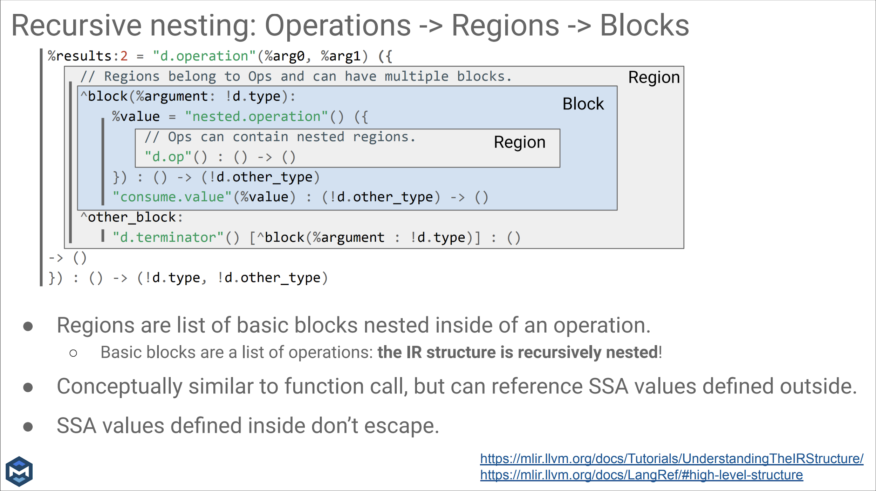

Slide 18
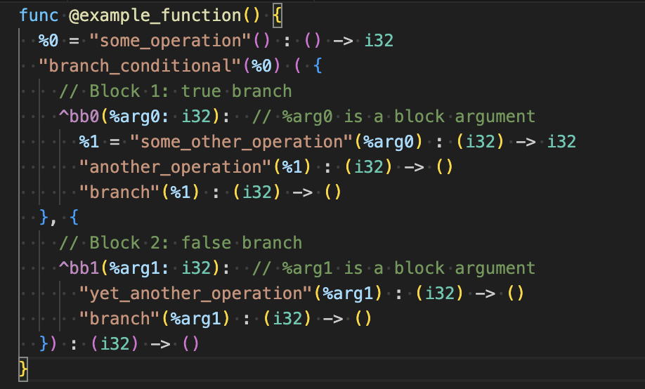
Block arguments
Mechanism to modify variables in a structured way that fit the similar purpose as PHI nodes in LLVM IR

Slide 19
Operations
Describe some action
Take arguments and returns them
Have generic op representation and custom printers
Example on the next slide
and here:
https://godbolt.org/z/cfjY375z7

Slide 20
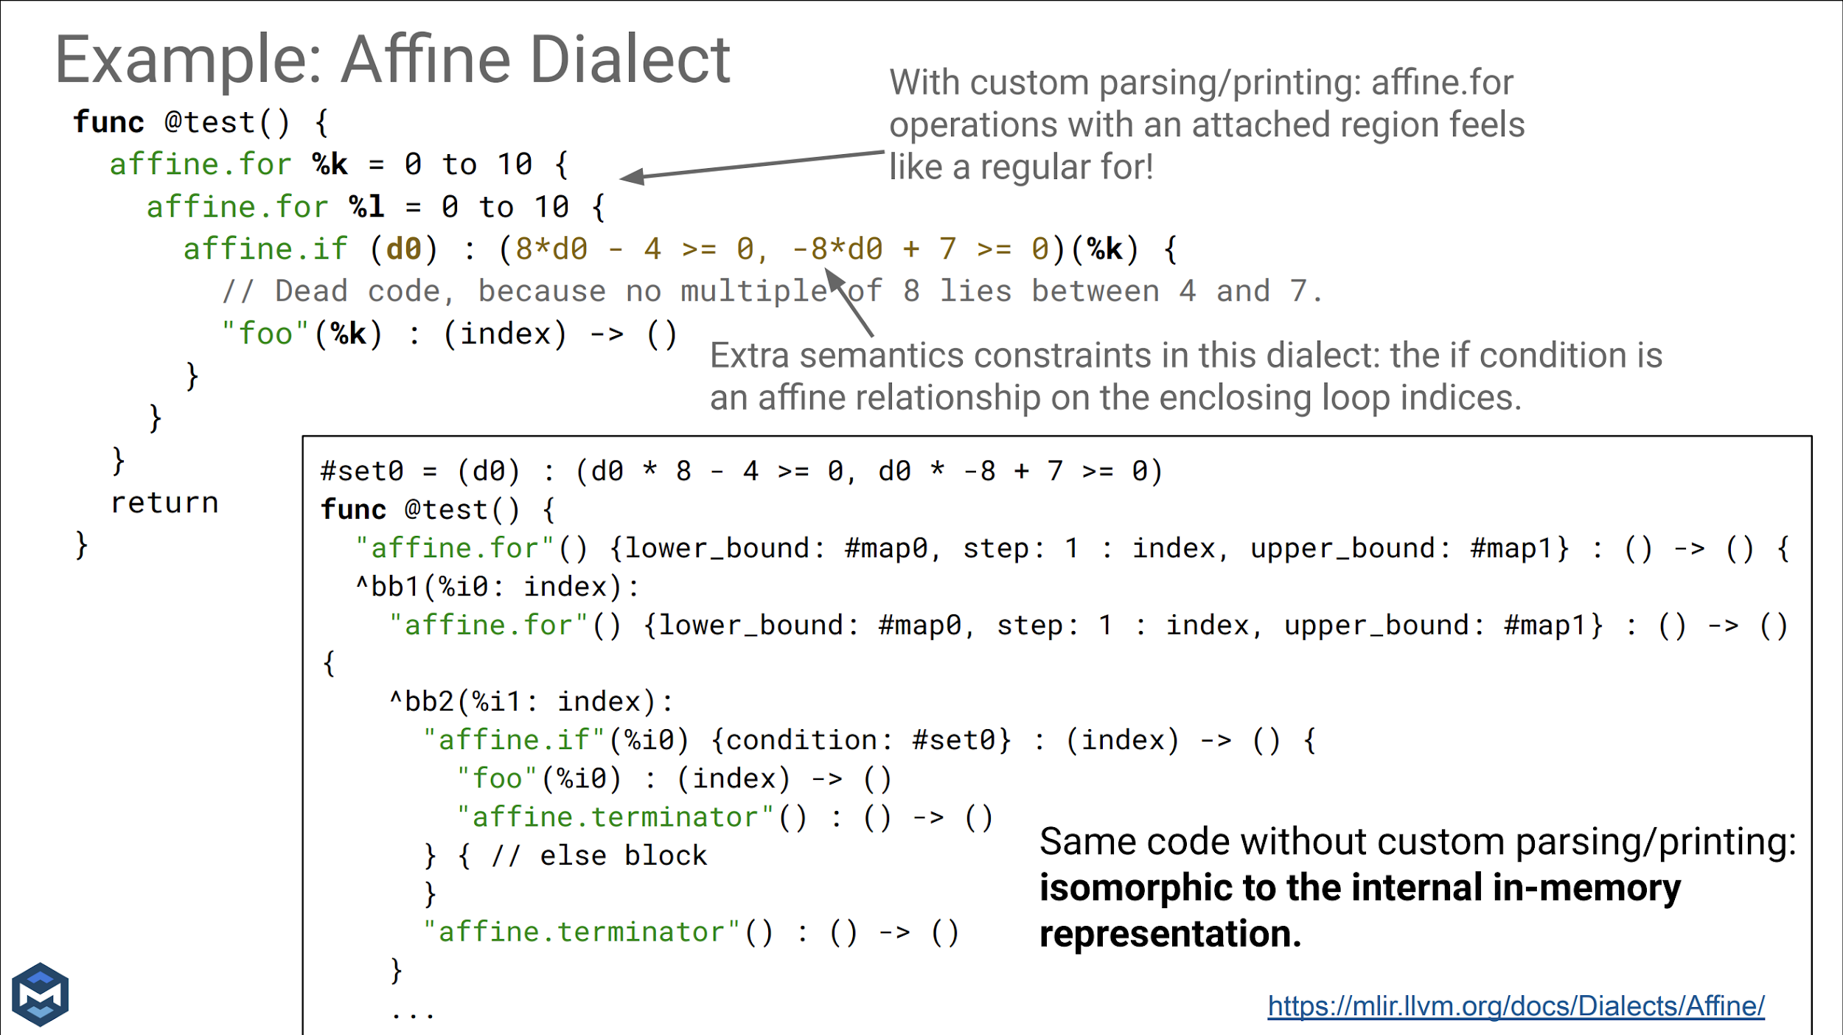

Slide 21
Pass infrastructure
MLIR provides a pass manager
Passes can be operation-agnostic or be run on specific operation
Pass manager is multithreaded
Independent operations can be processed simultaneously
Pass manager is dynamic
I.e., allows running another pass manager from within a pass
MLIR has built-in tools for reproducer generation

Slide 22
mlir-opt
opt analog for MLIR
help:
https://godbolt.org/z/x5zjxbq4T

Slide 23
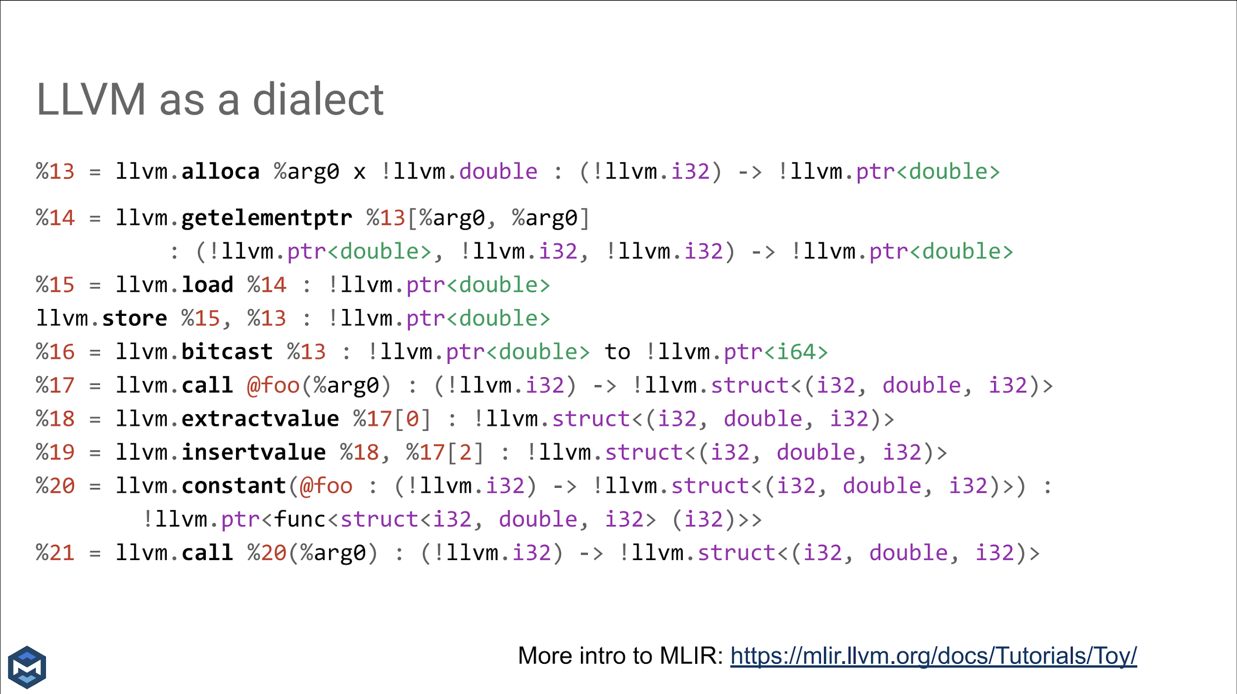

Slide 24
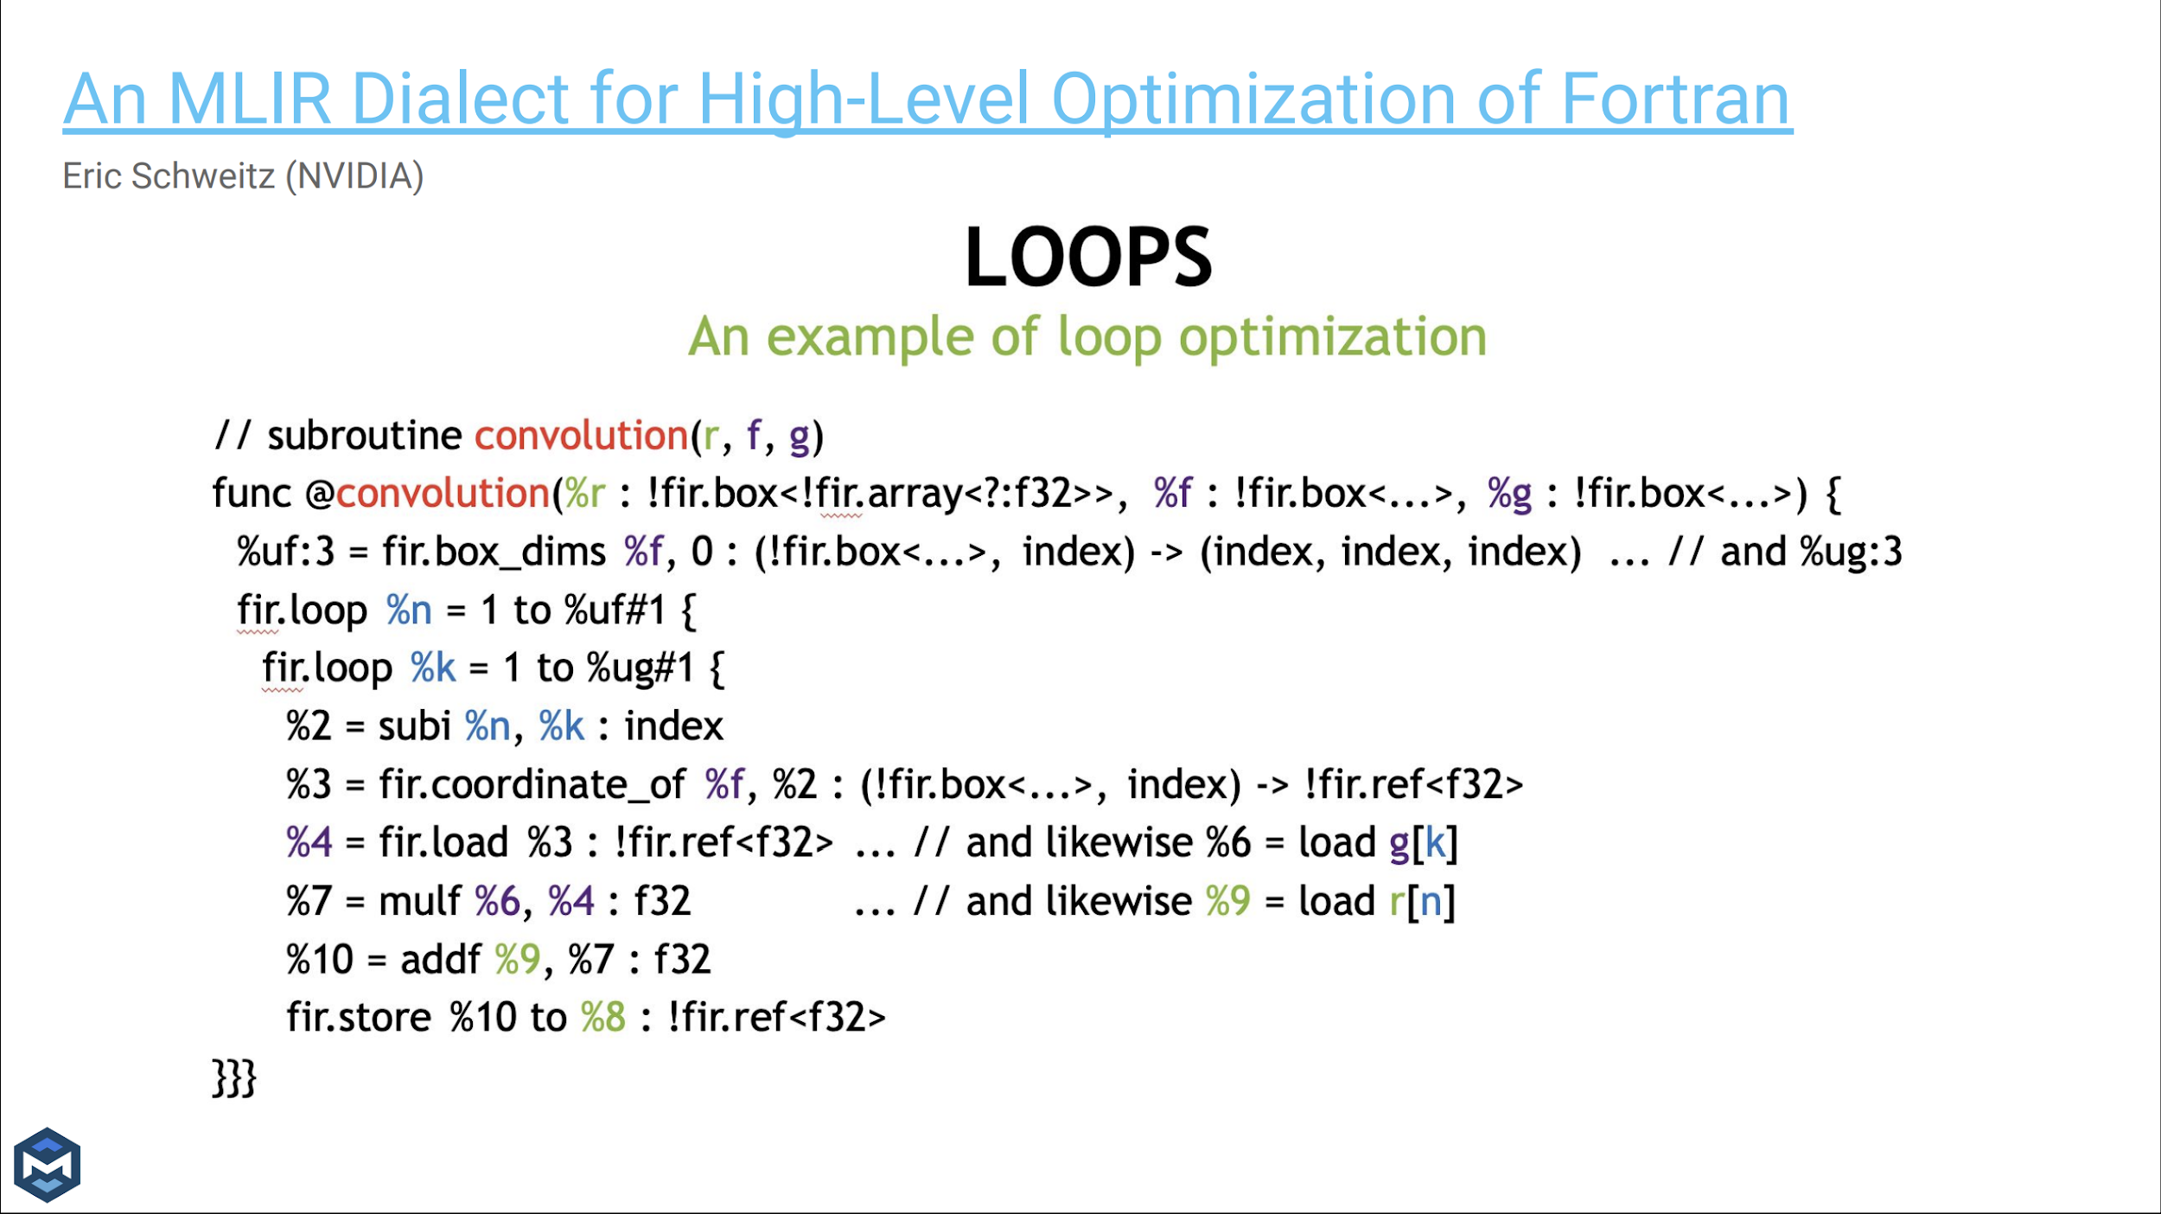

Slide 25
Advantages of MLIR
Modularity and extensibility
Easy to introduce needed dialects, passes and build the pipeline
Enables with better compiler development quality and rapid prototyping
Support for generic and domain specific optimizations
Enhanced reusability and interoperability
Improved analysis and debugging
Facilitates Heterogeneous Hardware Support

Slide 26
Disadvantages of MLIR
Increased Complexity
MLIR’s multi-level approach adds extra layers of abstraction compared to traditional single-level IRs
As a result, steep learning curve
Lack of stable API
Every commit to LLVM repo can potentially break the IR
Dialects zoo
Everyone comes up with their own dialect
Lack of tooling and ecosystem maturity
While MLIR is continuously evolving, its ecosystem is still maturing

Slide 27
Where MLIR is used?
flang - Fortran compiler
clang-based MLIR codegen for C/C++:
clangir
Polygeist (C/C++/CUDA C++)
CIRCT Project
Mojo
List of users updated by LLVM community:
https://mlir.llvm.org/users/

Slide 28
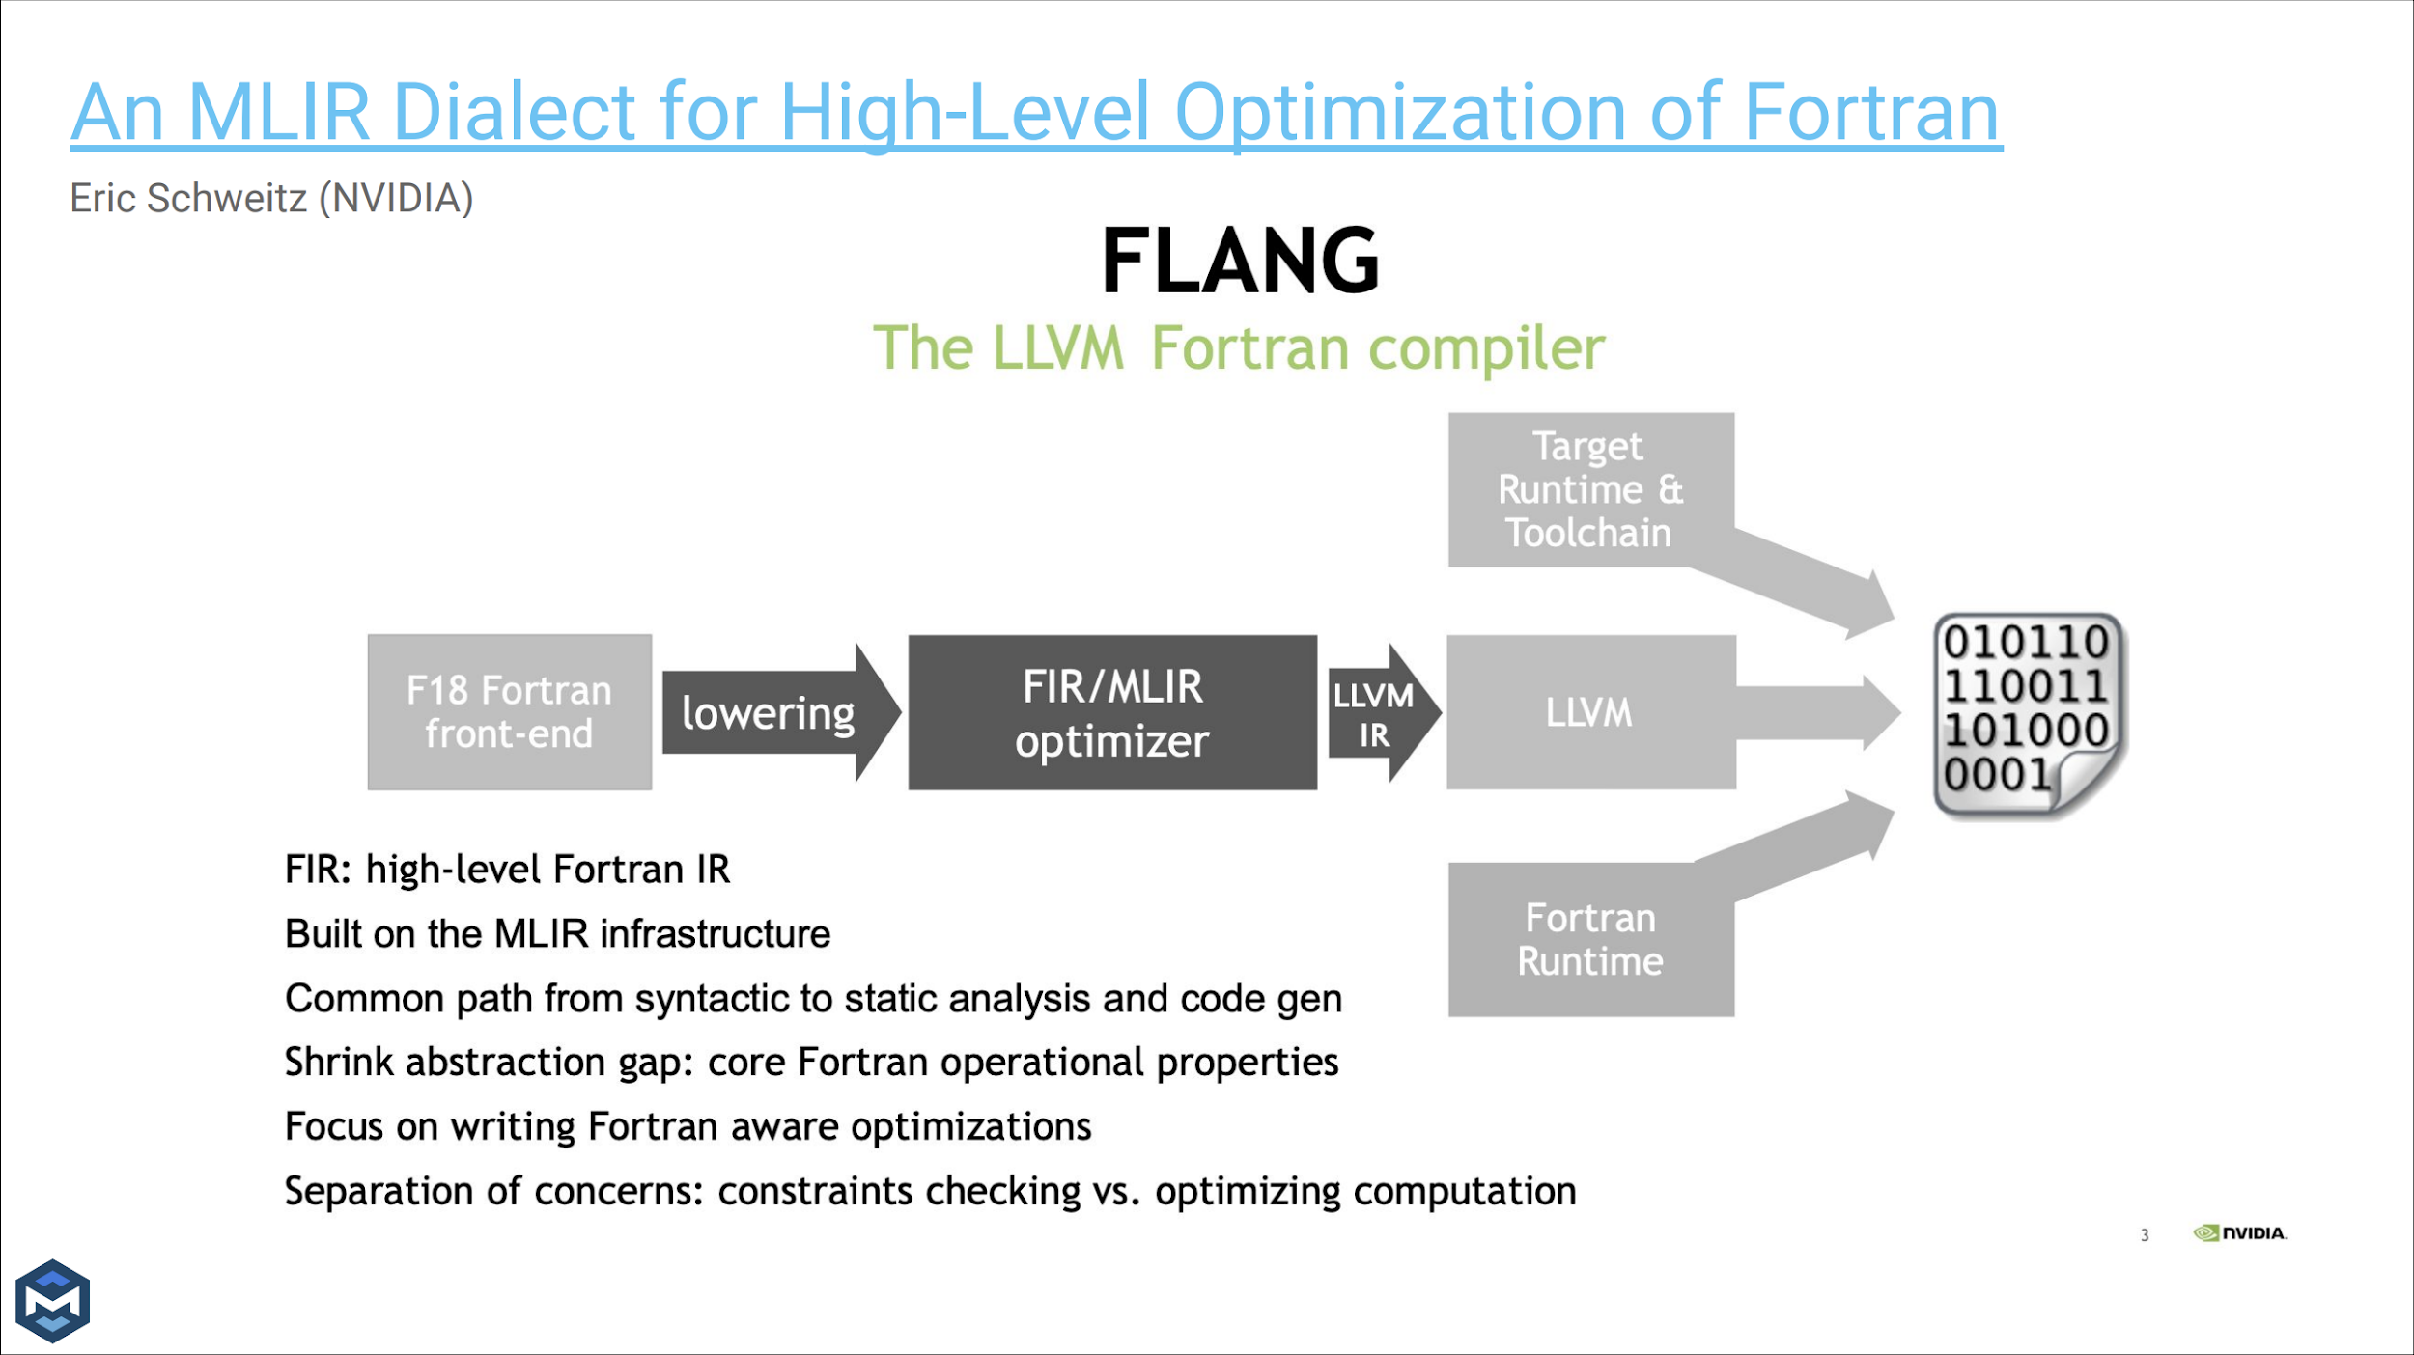

Slide 29
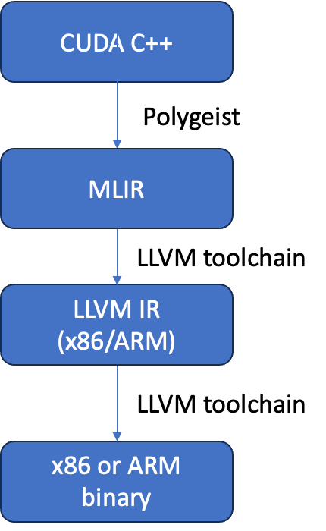
Polygeist
Convert C/C++/CUDA C++ to MLIR and apply polyhedral transformations to run it faster
Project: https://github.com/llvm/Polygeist

Slide 30
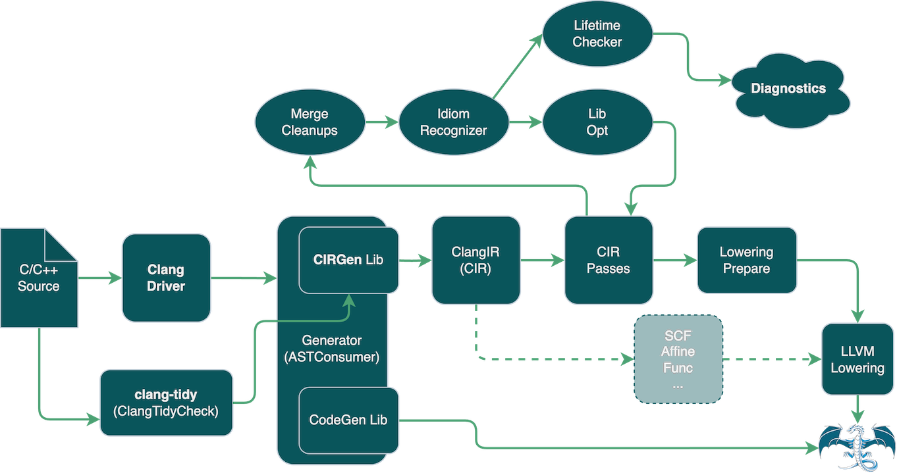
clangir
ClangIR integrates Clang’s C/C++ front-end capabilities with the MLIR framework, enabling a layered approach to transforming and optimizing code
ClangIR is inspired in the success of other languages that greatly benefit from a middle-level IR, such as Swift and Rust. Particularly, optionally attaching AST nodes to CIR operations is inspired by SIL references to AST nodes in Swift.
https://github.com/llvm/clangir
https://llvm.github.io/clangir/

Slide 31
Mojo 🔥 language
Mojo combines the usability of Python with the performance of C, unlocking unparalleled programmability of AI hardware and extensibility of AI models.
Mojo leverages MLIR, which enables Mojo developers to take advantage of vectors, threads, and AI hardware units.
https://www.modular.com/max/mojo

Slide 32
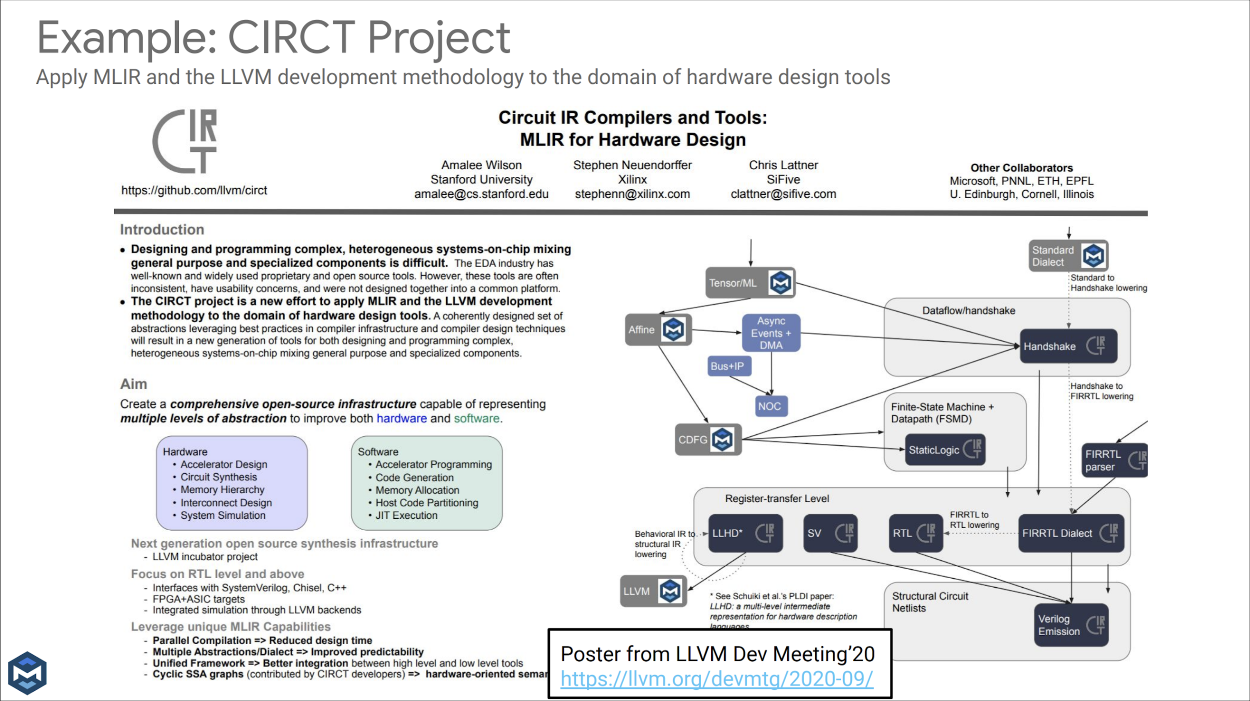

Slide 33
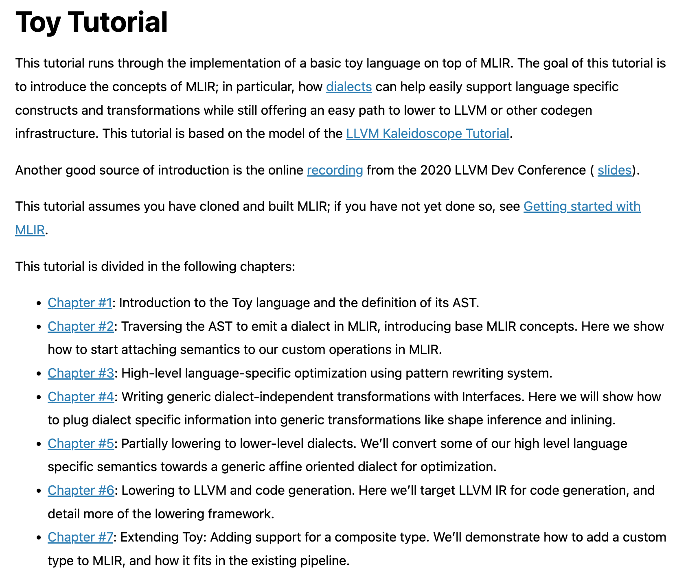
https://mlir.llvm.org/docs/Tutorials/Toy/

Slide 34
Next time
Connection with LLVM
Available transformations and optimizations overview
Custom dialects
Writing a pass

Slide 35


Test
https://forms.gle/nStZ9wudh2gAmJCG7
Submission time: 10 minutes
Backup: me@gooddoog.ru

Slide 36


Test
https://forms.gle/bR6K58M7p9YH6QxS8
Submission time: 10 minutes
Backup: me@gooddoog.ru

Slide 37
Extra materials
LLVM Compiler Infrastructure in HPC Workshop - https://www.youtube.com/watch?v=0bxyZDGs-aA
All MLIR talks: https://mlir.llvm.org/talks/
Toy language (MLIR tutorial): https://mlir.llvm.org/docs/Tutorials/Toy/Ch-1/
2023 EuroLLVM - What's new in MLIR? https://www.youtube.com/watch?v=LPlRLt9w4b0

